Slide 1
Personal Finance Management App
Group members
Samreen Abbasi- 6396941 Amrutha balumuri- 6334423 Gabriel Alberro - 6209261 Bhuvan Loknath - 6455938 Lewis Mesa - 6189964 Deepak Polasi Sai -6425586

Slide 2
Scenario
Designing a database for a personal finance management app. This app helps users track their income, expenses, budgets, and investments.

Slide 3
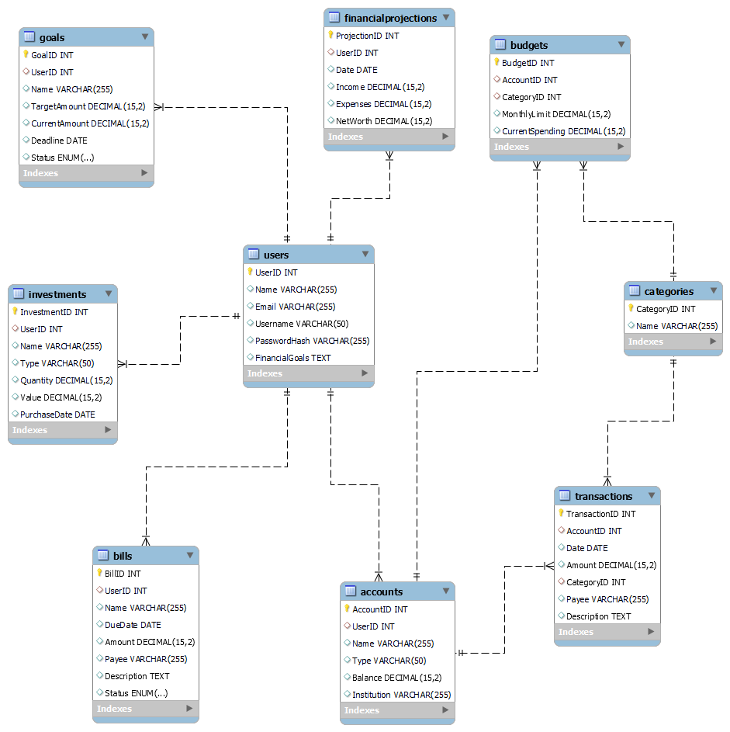
ER diagram

Slide 4
Tables
Users: Columns: UserID (PK), Name, Email, Username, Password (hashed), FinancialGoals (JSON)
Accounts: Columns: AccountID (PK), UserID (FK), Name, Type (Checking, Savings, CreditCard, Investment), Balance, Institution
Transactions: Columns: TransactionID (PK), AccountID (FK), Date, Amount, Category, Payee (optional), Description
Budgets: Columns: BudgetID (PK), UserID (FK), Name, Category, MonthlyLimit, CurrentSpending

Slide 5
Investments:
Columns: InvestmentID (PK), UserID (FK), Name, Type (Stock, Bond, etc.), Quantity, Value, PurchaseDate.
Categories:
Columns: CategoryID (PK), Name
Bills:
Columns: BillID (PK), UserID (FK), Name, DueDate, Amount, Payee, Description, Status
FinancialProjections:
Columns: ProjectionID (PK), UserID (FK), Date, Income, Expenses, NetWorth
Goals:
Columns: GoalID (PK), UserID (FK), Name, TargetAmount, CurrentAmount, Deadline, Status

Slide 6
Relationships
One user can have many accounts (One-to-Many).
One account can have many transactions (One-to-Many).
One user can have many budgets (One-to-Many).
One user can have many investments (One-to-Many).
One transaction belongs to one account (Many-to-One).
One budget belongs to one user (Many-to-One).
One investment belongs to one user (Many-to-One).

Slide 7

SQL queries

Slide 8
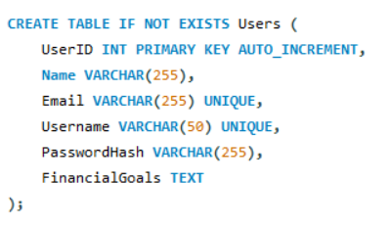

Slide 9
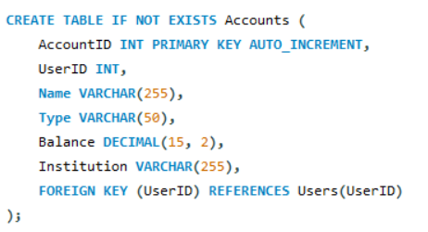

Slide 10
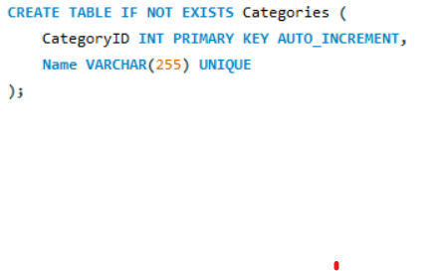

Slide 11
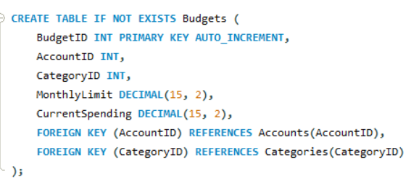

Slide 12
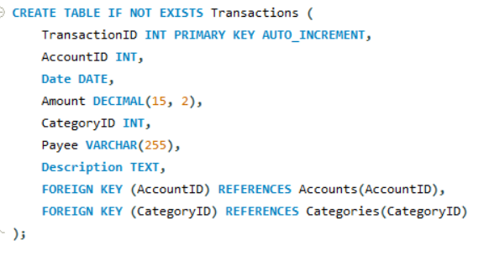

Slide 13
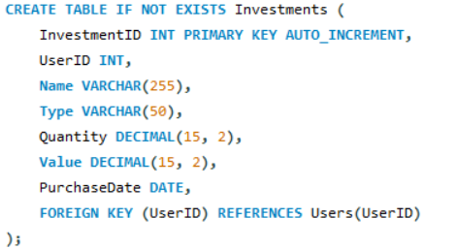

Slide 14
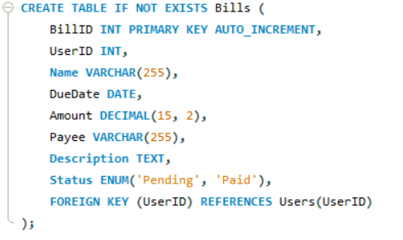

Slide 15
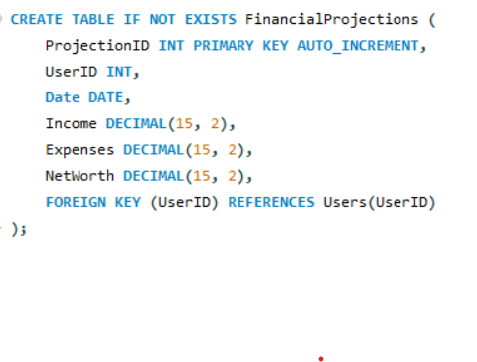

Slide 16
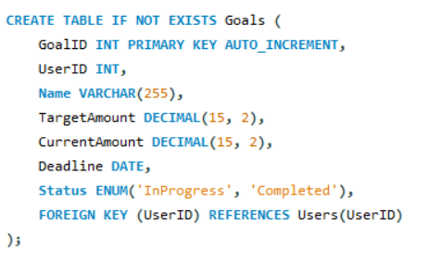

Slide 17
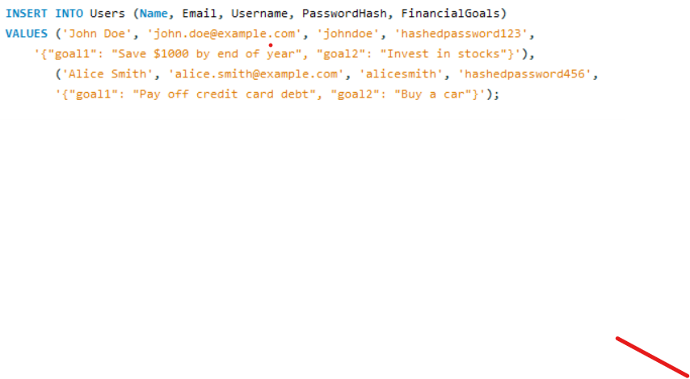
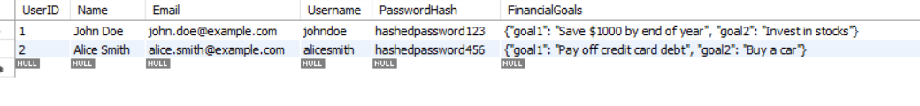
Values inserted

Slide 18
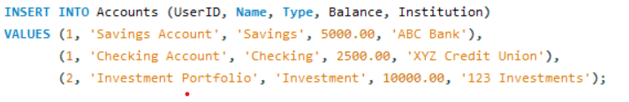
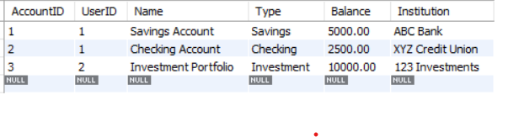

Slide 19
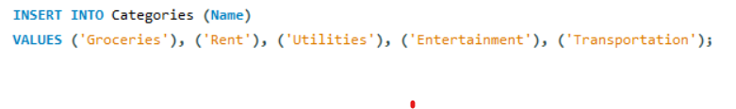
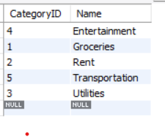

Slide 20
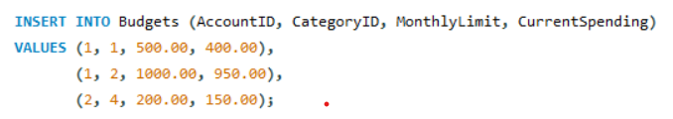
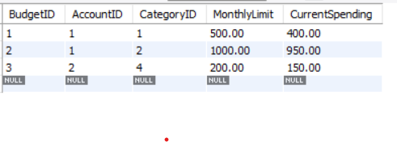

Slide 21
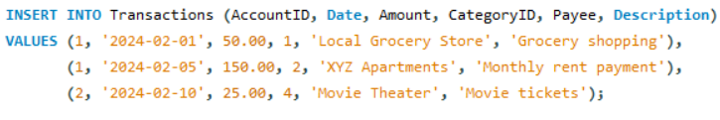
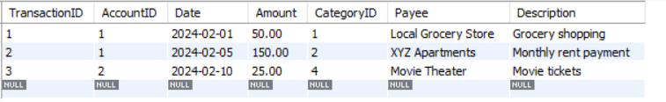

Slide 22



Slide 23
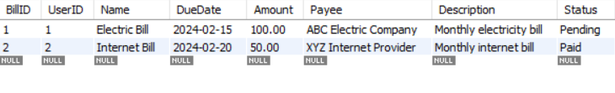

Slide 24

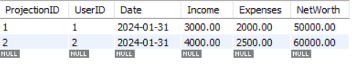

Slide 25



Slide 26
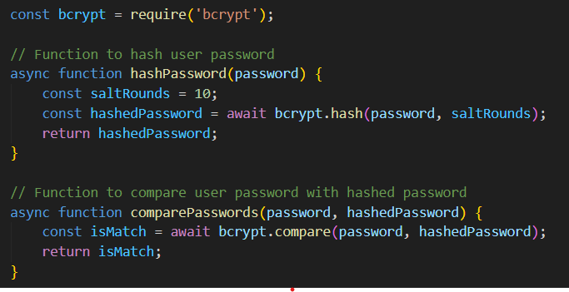
hashing
Bycrypt algorithm

Slide 27
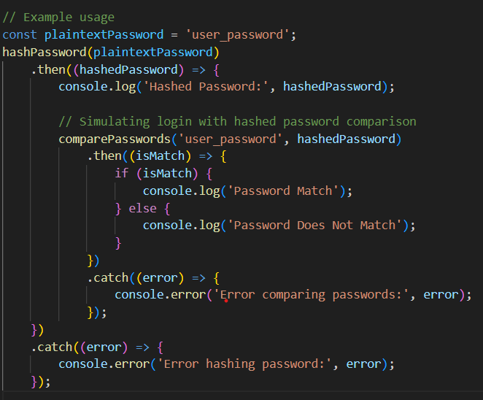

Slide 28
THE END

